Slide 1
How to apply statistics
Vinay Mahajan
Varsha Mahajan
Regression Theory

Slide 2
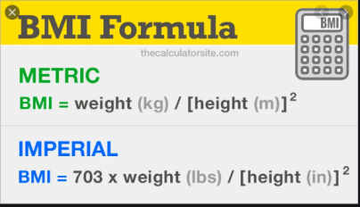
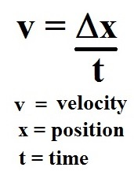
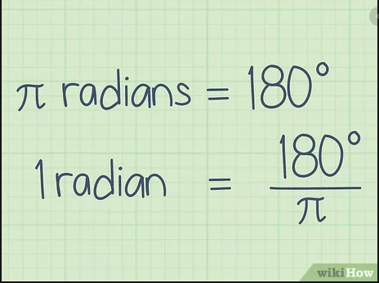
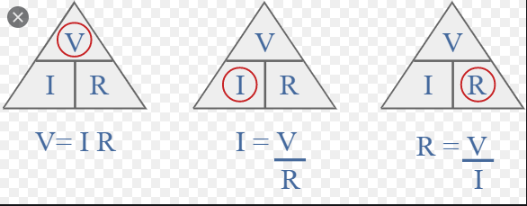
Relation between variables
Deterministic | Statistical (not perfect)
BMI formula | More amount of study – more marks Less amount of study – less marks
Velocity formula | More exercise – better health
Radians to degree | High smoking – cancer / lung disease Low smoking
Ohm’s law | High calorie intake - weight Low calorie intake – weight
...
https://www.thecalculatorsite.com/images/health/bmi-formula.png?ezimgfmt=ng:webp/ngcb20
https://study.com/cimages/multimages/16/velocity_eqn.jpg
https://www.wikihow.com/images/thumb/d/d4/Convert-Radians-to-Degrees-Step-1-Version-4.jpg/v4-460px-Convert-Radians-to-Degrees-Step-1-Version-4.jpg.webp
https://www.electronics-notes.com/images/ohms-law-triangle-02.svg

Slide 3
Regression: Purpose of Linear Relationship
The primary purpose of Regression analysis is the development of an equation that can be used for predicting values on some Dependent Variable, Y, given Independent Variables, X, for all members of a population.
One of the most important functions of science is the description of natural phenomenon in terms of ‘functional relationships’ between variables. E.g. If one is given a temperature value in the ºC Scale (say X), then the corresponding value in the Fahrenheit Scale (say Y), can be calculated by the formula:
Y = 32 + 1.8 X
If the ºC temperature = 10, the Fahrenheit temperature =:
Y = 32 + 1.8 (10) = 32 + 18 = 50
Similarly, if the ºC = 20, the Fahrenheit temperature must be:
Y = 32 + 1.8 (20) = 32 + 36 = 68
We can plot this relationship on the usual rectangular system of coordinates.

Slide 4
What is “Linear”?
Remember this:
Y=a + bX ?
X = Independent variable
Y = Dependent variable
b = Slope (angle and direction)
a = Intercept (point at which line intersects Y axis)
E.g. Y = 2X, A slope of 2 means that every 1-unit change in X yields a 2-unit change in Y.
b
a

Slide 5
Reference to the UPenn website
https://online.stat.psu.edu/stat462/node/91/
Causation and correlation
https://sphweb.bumc.bu.edu/otlt/MPH-Modules/PH717-QuantCore/PH717-Module1A-Populations/PH717-Module1A-Populations6.html

Slide 6
The Correlation
Anscombe's Quartet: to demonstrate both the importance of graphing data before analyzing it
and the effect of outliers on statistical properties.
 | I |  | II |  | III |  | IV
 | x | y | x | y | x | y | x | y
 | 10 | 8.04 | 10 | 9.14 | 10 | 7.46 | 8 | 6.58
 | 8 | 6.95 | 8 | 8.14 | 8 | 6.77 | 8 | 5.76
 | 13 | 7.58 | 13 | 8.74 | 13 | 12.74 | 8 | 7.71
 | 9 | 8.81 | 9 | 8.77 | 9 | 7.11 | 8 | 8.84
 | 11 | 8.33 | 11 | 9.26 | 11 | 7.81 | 8 | 8.47
 | 14 | 9.96 | 14 | 8.1 | 14 | 8.84 | 8 | 7.04
 | 6 | 7.24 | 6 | 6.13 | 6 | 6.08 | 8 | 5.25
 | 4 | 4.26 | 4 | 3.1 | 4 | 5.39 | 19 | 12.5
 | 12 | 10.84 | 12 | 9.13 | 12 | 8.15 | 8 | 5.56
 | 7 | 4.82 | 7 | 7.26 | 7 | 6.42 | 8 | 7.91
 | 5 | 5.68 | 5 | 4.74 | 5 | 5.73 | 8 | 6.89
 | I | II | III | IV
Mean | 9 | 7.5 | 9 | 7.5 | 9 | 7.5 | 9 | 7.5
Var | 11 | 4.12 | 11 | 4.12 | 11 | 4.12 | 11 | 4.12
Cor | 0.816 |  | 0.816 |  | 0.816 |  | 0.816
Linear regression line in each case : y = 3 + 0.5x
Slide from Day_2_Why Statistics

Slide 7
Regression and Prediction
As a university admissions officer, what GPA would you predict for a student who earns a score of 650 on SAT-V ?
If the relationship between X and Y is not perfect, you should attach error to your prediction.
Correlation and Regression
Determining the Line of Best Fit or Regression Line using Least Squares Criterion.

Slide 8
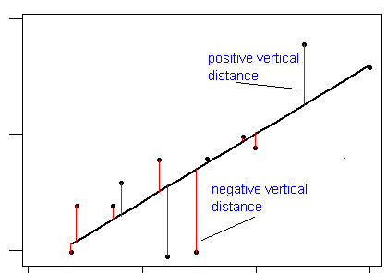
Selection of Regression Line
Residual or error of prediction = (Y –Y’)
Positive or negative
Regression line, Y’ = a + bX, is chosen so that the sum of the squared prediction error for all cases, ∑(Y- Y’)², is as small as possible

Slide 9
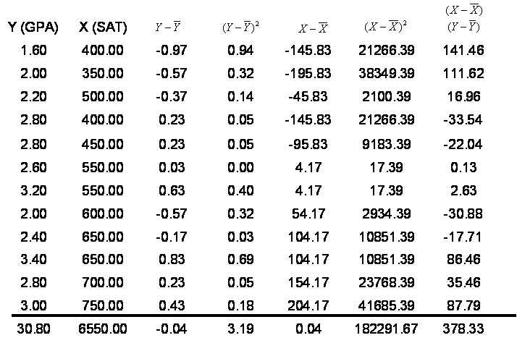
Calculation of Regression Line
Calculate
sum

Slide 10
Calculation of Regression Line
Continued
Calculate
deviation
from average Y

Slide 11
Calculation of Regression Line
Continued
Calculate
deviation
from average X

Slide 12
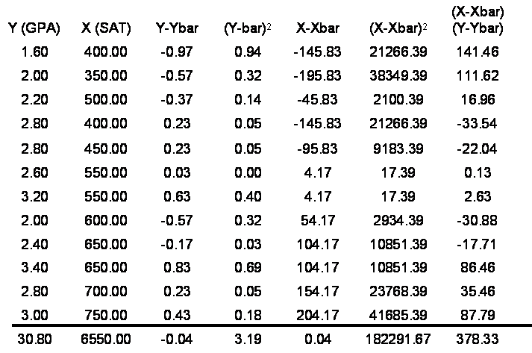
Calculation of Regression Line
Continued
Calculate
product of deviation from X and Y

Slide 13
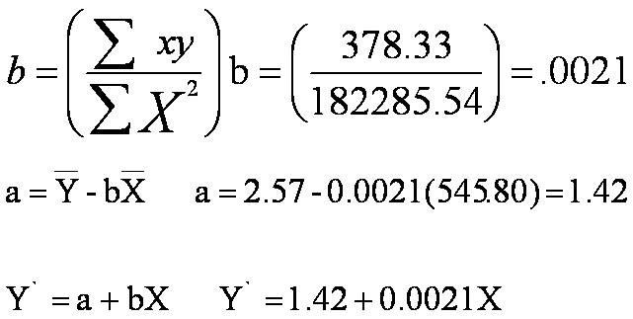
Calculation of Regression Line
Continued

Slide 14
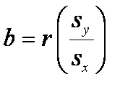
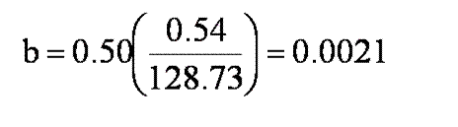
Calculation of Regression Line
Continued
Standard
Deviation of Y
Standard
Deviation of X
Correlation of X & Y

Slide 15
Calculation of Regression Line
Continued

Slide 16
Calculation of Regression Line
Continued
a = 1.42
b = .0021
Y’ = 1.42 + .0021 X

Slide 17
Calculation of Predicted Values and Residuals
 | Y (GPA) | X (SAT) | Y’ | Y-Y’
 | 1.60 | 400.00 | 2.26 | -0.66
 | 2.00 | 350.00 | 2.16 | -0.16
 | 2.20 | 500.00 | 2.47 | -0.27
 | 2.80 | 400.00 | 2.26 | 0.54
 | 2.80 | 450.00 | 2.37 | 0.43
 | 2.60 | 550.00 | 2.58 | 0.02
 | 3.20 | 550.00 | 2.58 | 0.62
 | 2.00 | 600.00 | 2.68 | -0.68
 | 2.40 | 650.00 | 2.78 | -0.38
 | 3.40 | 650.00 | 2.78 | 0.62
 | 2.80 | 700.00 | 2.89 | -0.09
 | 3.00 | 750.00 | 2.99 | 0.01
Sum | 30.80 | 6550.00 | 30.80 | 0.00
Average | 2.57 | 545.83 | 2.57 | 0.00
Y’ = 1.42 + .0021 X

Slide 18
Plot of Data

Slide 19
Plot of Data
Slope shows change in Y
associated to
to change
in one unit of X
Intercept
Regression line shows
predicted values. Difference between predicted & observed is the residual

Slide 20
Calculation of Regression Line Using Standard Deviations
Predicted weight = 811 + 9 Gestation days

Slide 21
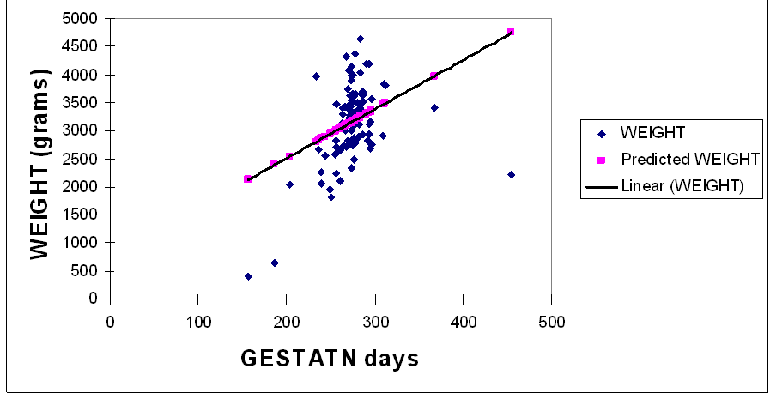
Relationship between Weight & Gestation Days
Predicted weight = 811 + 9 Gestation days
Regression equation: Y` = 811 + 9 X
Intercept

Slide 22
Predicting Weight from Gestation Days
If a baby’s gestation is… | Add Intercept | Plus Coefficient TIMES gestation | Predicted Weight
250 | 811 | 811 + 9* (250) | 3061
260 | 811 | 811 + 9* (260) | 3151
270 | 811 | 811+ 9* (270) | 3241
280 | 811 | 811 + 9* (280) | 3331
300 | 811 | 811 + 9* (300) | 3511

Slide 23
Sources of Variation
The sum of Squares of the Dependent Variable is partitioned into two components:
One due to Regression (Explained)
One due to Residual (Unexplained)
Notes:
Similarities between ANOVA and regression

Slide 24
Partitioning of Sum of Squares
Notes:
Short cut

Slide 25
Testing Statistical Significance of Variance Explained
Source of variation | SS | df
Regression | 0.80 2.40 | 1 10
Residual
Total | 3.20 | 11

Slide 26
Testing Statistical Significance of Variance Explained
Continued
Source of variation | SS | df | MS
Regression | 0.80 2.40 | 1 10 | 0.80 0.24
Residual
Total | 3.20 | 11

Slide 27
Testing Statistical Significance
Continued
Source of variation | SS | df | MS | F | F_{α}
Regression | 0.80 2.40 | 1 10 | 0.80 0.24 | 3.33 | 4.90
Residual
Total | 3.20 | 11
Testing the proportion of variance due to regression
H₀ : R² = 0 Since the F< F_{α} fail to reject H_{o}
H_{a} : R² ≠ 0

Slide 28
Testing Statistical Significance of Regression Coefficient
B. Testing the Regression Coefficient
H₀ : β = 0 Since the p> α Fail to reject H_{o}
H_{a} : β ≠ 0

Slide 29
Standard Error of Estimate of Y Regressed on X

Slide 30
Interpretation of Standard Error of Estimate
The average amount of error in predicting GPA scores is 0.49.
The smaller the standard error of estimate, the more accurate the predictions are likely to be.

Slide 31
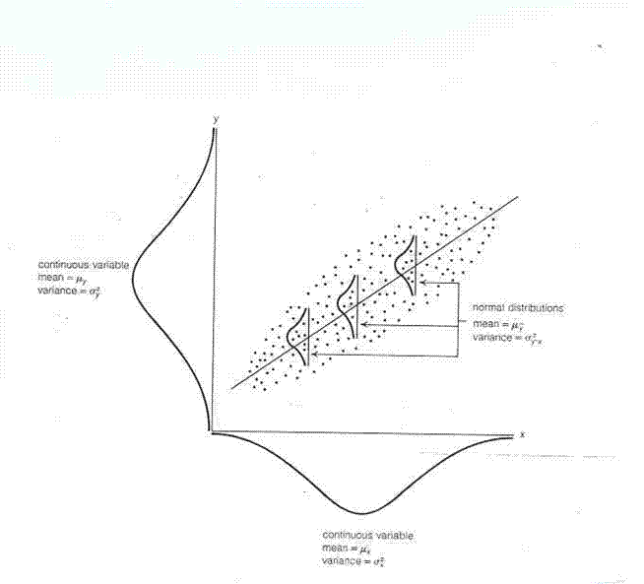
Assumptions
X and Y are normally distributed

Slide 32
Assumptions
Continued
X and Y are normally distributed
The relationship between X and Y is linear and not curved

Slide 33
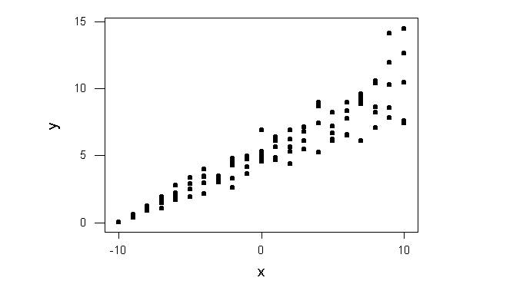
Assumptions
Continued
X and Y are normally distributed
The relationship between X and Y is linear and not curved
The variation of Y at particular values of X is not proportional to X

Slide 34
Assumptions
Continued
X and Y are normally distributed
The relationship between X and Y is linear and not curved
The variation of Y at particular values of X is not proportional to X
There is negligible error in measurement of X

Slide 35
Residual Analysis: check assumptions
The residual for observation i, e_{i}, is the difference between its observed and predicted value
Check the assumptions of regression by examining the residuals
Examine for linearity assumption
Examine for constant variance for all levels of X (homoscedasticity)
Evaluate normal distribution assumption
Evaluate independence assumption
Graphical Analysis of Residuals
Can plot residuals vs. X

Slide 36
Residual Analysis for Linearity
Y
Y
x
x
residuals
x
x
residuals
Not Linear
✓
Linear
Slide from: Statistics for Managers Using Microsoft® Excel 4th Edition, 2004 Prentice-Hall

Slide 37
Residual Analysis for Homoscedasticity
Y
Y
x
x
residuals
x
x
residuals
✓
Non-constant variance
Constant variance
Slide from: Statistics for Managers Using Microsoft® Excel 4th Edition, 2004 Prentice-Hall

Slide 38
Residual Analysis for Independence
Not Independent
✓
Independent
residuals
X
residuals
X
residuals
X
Slide from: Statistics for Managers Using Microsoft® Excel 4th Edition, 2004 Prentice-Hall

Slide 39
The Use of Simple Regression
Answering Research Questions and Testing Hypothesis
Making Prediction about Some Outcome or Dependent Variable
Assessing an Instrument Reliability
Assessing an Instrument Validity

Slide 40
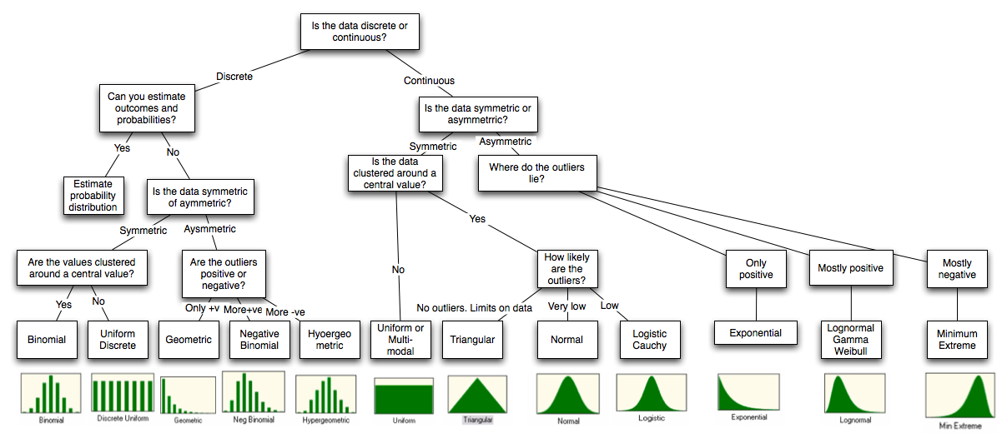
Basic statistics
Different distributions to explain the shape

Slide 41
Linear correlation
The Correlation
These examples indicate that the correlation coefficient, as a summary statistic, cannot replace the individual examination of the data.

Slide 42
Linear correlation
The Correlation
Example 1 Sleeping with one's shoes on is strongly correlated with waking up with a headache. Therefore, sleeping with one's shoes on causes headache. This commits the correlation-implies-causation fallacy, as it prematurely concludes that sleeping with one's shoes on causes headache. A more plausible explanation is that both are caused by a third factor, in this case alcohol intoxication, which thereby gives rise to a correlation.
Example 2 Young children who sleep with the light on are much more likely to develop myopia in later life. Scientific example from a study at the University of Pennsylvania Medical Center. Published in the May 13, 1999 issue of Nature. However, a later study at The Ohio State University did not find that infants sleeping with the light on caused the development of myopia. It did find a strong link between parental myopia and the development of child myopia, also noting that myopic parents were more likely to leave a light on in their children's bedroom. In this case, the cause of both conditions is parental myopia.
Example 3 As ice cream sales increase, the rate of drowning deaths increases sharply. So, ice cream causes drowning. This example fails to recognize the importance of time in relationship to ice cream sales. Ice cream is sold during the summer months at a much greater rate, and it is during the summer months that people are more likely to engage in activities involving water, such as swimming. The increased drowning deaths are simply caused by more exposure to water based activities, not ice cream.
Coincidence: (1) Since the 1950s, both the atmospheric CO2 level & crime levels have increased sharply. Hence, atmospheric CO2 causes crime. (2) With a decrease in the number of pirates, there has been an increase in global warming over the same period. Therefore, global warming is caused by a lack of pirates.

Slide 43
Linear correlation
The Correlation
Correlation does not imply causation

